Slide 1

SSMS – MSSQL Server
Venkat Gandhi
SQL Server Relational Database Management System is platform independent (runs on Linux and Windows) was developed by Microsoft
To Create and Maintain databases. (SQL Server Database Engine).
It also has SQL Server Analysis Services, SQL Server Reporting Services, SQL Server Integration Services.
Downloads
SQL Server
SQL Server Management Studio
SQL Server version 6.0 released in 1995 was the first version.
Version | Year
6.0 | 1995
6.5 | 1996
7.0 | 1998
8.0 (2000) | 2000
9.0 (2005) | 2005
10.0 (2008) | 2008
10.5 (2008 R2) | 2010
11.0 (2012) | 2012
12 (2014) | 2014
13 (2016) | 2016
14 (2019) | 2019
15 (2022) | 2022

Slide 2
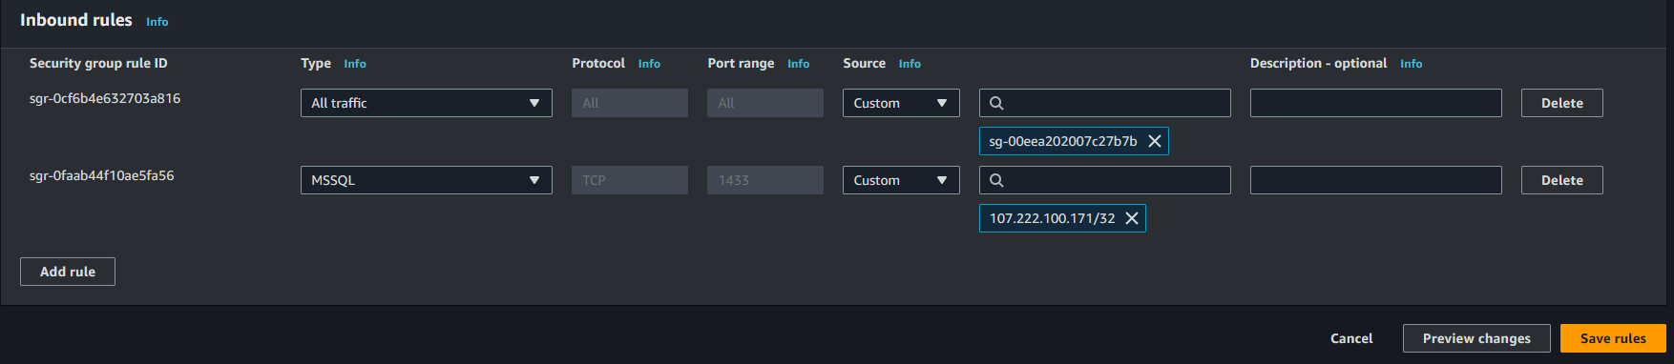
AWS RDS – MSSQL Server
Venkat Gandhi
Steps to Setup a Database in AWS
Search RDS in aws console.
Click Create Database
Select SQL Server as database Engine
Provide Server Master Password for SQL Server.
Select Public Access = Yes
Click create Database
Wait for the DB server to be created.
Once created, Edit inbound rules to allow your ip address to MSSQL.

Slide 3
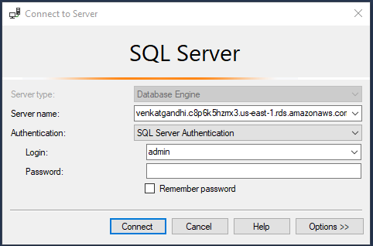
SQL Server Management Studio
Venkat Gandhi
Steps to Connect to RDS using SQLS Server Management Studio
Enter the server URL followed by , and port example.
Server Type: Database Engine
ServerName: venkatgandhi.xxxxxxxxxxxx.us-east-1-rds.amazonaws.com,1443
Login Id: (Id that was created during creation of Database).
Login Password: (Password that was created during creation of Database).

Slide 4
SQL Server Management Studio
Venkat Gandhi
Steps to Connect to RDS using SQLS Server Management Studio
Enter the server URL followed by , and port example.
Server Type: Database Engine
ServerName: venkatgandhi.xxxxxxxxxxxx.us-east-1-rds.amazonaws.com,1443
Login Id: (Id that was created during creation of Database).
Login Password: (Password that was created during creation of Database).

Slide 5
Links
Venkat Gandhi
SQL Tutorial (tutorialspoint.com)
MS SQL Server Tutorial - tutorialspoint.com
T-SQL Tutorial: Create and query database objects - SQL Server
Hierarchical vs Relational Database: How Each Model Helps in Data Integration? (dataintegrationinfo.com)

Slide 6
TSQL - DataTypes
Venkat Gandhi
Data Types
Numeric | Date & Time | Strings | Binary
bigint | datetime | char | binary
int | smalldatetime | varchar | varbinary
smallint | date | text | image
tinyint | Dateoftimeoffset | nchar
bit | datetime2 | nvarchar
decimal | time | ntext
numeric
money
smallmoney
float
real

Slide 7
Table
Venkat Gandhi

Slide 8
Table
Venkat Gandhi
Create database => CREATE DATABASE VenkatDB Select * from Customers;
Create Table => Select * from Customers where state = ‘Texas’
CREATE TABLE CUSTOMERS( Update customers set State = ‘Michigan’ where id = 7
ID INT NOT NULL, Delete from customers where id = 7
NAME VARCHAR (20) NOT NULL, select * FROM CUSTOMERS WHERE STATE LIKE ‘%Tex%’ Select * from customers order by name desc
AGE INT NOT NULL, select name, sum(salary) as [sum of salary] from customers group by name.
STATE CHAR (25) , select distinct salary from customers
SALARY DECIMAL (18, 2),
PRIMARY KEY (ID));
Drop Table => Drop Table VenkatDB
List Table coloumns => Exec sp_colomns Customers;
INSERT INTO CUSTOMERS (ID,NAME,AGE,STATE,SALARY) VALUES (1, 'Fahad', 32, 'Ohio', 2000.00 );
INSERT INTO CUSTOMERS (ID,NAME,AGE,STATE,SALARY) VALUES (2, 'Rubal', 25, 'Texas', 1500.00 );
INSERT INTO CUSTOMERS (ID,NAME,AGE,STATE,SALARY) VALUES (3, 'Ian', 23, 'Texas', 2000.00 );
INSERT INTO CUSTOMERS (ID,NAME,AGE,STATE,SALARY) VALUES (4, 'Pourna', 25, 'Texas', 6500.00 );
INSERT INTO CUSTOMERS (ID,NAME,AGE,STATE,SALARY) VALUES (6, 'Kelton', 22, 'Texas', 4500.00 );
INSERT INTO CUSTOMERS (ID,NAME,AGE,STATE,SALARY) VALUES (7, 'Venkat', 16, 'Texas', 4500.00 );

Slide 9
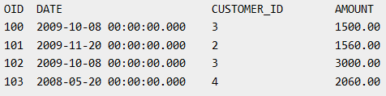
Table
Venkat Gandhi
Orders table
SELECT ID, NAME, AGE, AMOUNT
FROM CUSTOMERS, ORDERS
WHERE CUSTOMERS.ID = ORDERS.CUSTOMER_ID
OR
SELECT A.ID, A.NAME, A.AGE, B.AMOUNT
FROM CUSTOMERS A inner join ORDERS B on A.ID = B.Customer_ID

